Slide 1
Vector Auto Regression
Time Series Analysis
1
Group No:5
Tanmay Desai –A006
Sachin Dwivedi –A008
Rohit Fuke-A010
Dhruv Gilda- A012
Harsh –A020

Slide 2
What is Vector Auto Regression?
Vector Auto Regression, is a statistical method used for time series analysis and forecasting.
It is particularly useful when dealing with multiple time series variables that are interrelated.
In VAR, you model the dependencies and relationships among these variables by considering their past values.
VAR Is different from other Autoregressive models like AR, ARMA or ARIMA
A Vector autoregressive (VAR) model is useful when one is interested in predicting multiple time series variables using a single model
VAR model is an extension of the univariate autoregressive model.

Slide 3
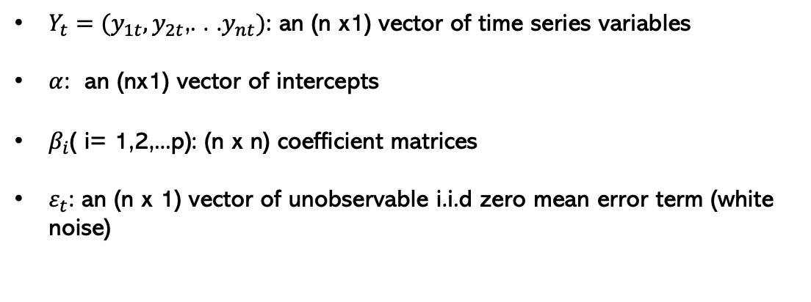
VAR Model Structure
Var(p) model
$$Y_{t}=α+β_{1}Y_{t−1}+β_{2}Y_{t−2}+. . . .+β_{p}Y_{t−p}+ε_{t}$$
$Y_{t}=(y_{1t}{,y}_{2t}$,. . .$y_{nt})$: an (n x1) vector of time series variables
$α$: an (nx1) vector of intercepts
$β_{i}$( i= 1,2,...p): (n x n) coefficient matrices
$ε_{t}$: an (n x 1) vector of unobservable i.i.d zero mean error term (white noise)

Slide 4
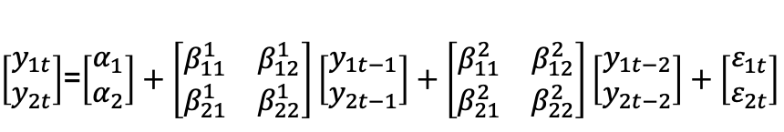

VAR Model Structure
Example: Bivariate Var(2) Model
$\left[\begin{aligned}y_{1t} \\ y_{2t}\end{aligned}\right]$=$\left[\begin{aligned}α_{1} \\ α_{2}\end{aligned}\right]+\left[\begin{matrix}β_{11}^{1} & β_{12}^{1} \\ β_{21}^{1} & β_{22}^{1}\end{matrix}\right]\left[\begin{aligned}y_{1t−1} \\ y_{2t−1}\end{aligned}\right]+\left[\begin{matrix}β_{11}^{2} & β_{12}^{2} \\ β_{21}^{2} & β_{22}^{2}\end{matrix}\right]\left[\begin{aligned}y_{1t−2} \\ y_{2t−2}\end{aligned}\right]+\left[\begin{aligned}ε_{1t} \\ ε_{2t}\end{aligned}\right]$
Or:
$$y_{1t}=α_{1}+β_{11}^{1}y_{1t−1}+β_{12}^{1}y_{2t−1}+β_{11}^{2}y_{1t−2}+β_{12}^{2}y_{2t−2}+ε_{t}$$
$$y_{2t}=α_{2}+β_{21}^{1}y_{1t−1}+β_{22}^{1}y_{2t−1}+β_{21}^{2}y_{1t−2}+β_{22}^{2}y_{2t−2}+ε_{t}$$

Slide 5
Assumptions of VAR
Linearity: Assumes linear relationships between variables.
Stationarity: Requires stable statistical properties over time.
No Multicollinearity: Variables shouldn't have perfect linear relationships.
No Serial Correlation: Errors at one time shouldn't depend on past errors.
Homoscedasticity: Assumes constant error variance over time.

Slide 6
Application of VAR Model
Economics and Finance:
VAR models used in macroeconomics to analyze the interdependencies between economic variables such as GDP, inflation, interest rates etc.
Healthcare:
To analyze and forecast the spread of diseases, especially during pandemics, by considering factors like infection rates, public health interventions, and healthcare resource utilization.
Enviromental Science :
Climate Modeling: To understand and forecast complex interactions among climate variables, such as temperature, precipitation, and atmospheric pressure.
Supply Chain Management:
To forecast demand, optimize inventory levels, and improve supply chain efficiency by considering variables like production, orders, and lead times etc.

Slide 7
Example:
We have a Quarterly Economic Indicators Dataset. In which we are considering the ‘Real Gross National Product(rgnp)’ and ‘Unit Labour Cost(ulc)’ for analysis.
date | rgnp | pgnp | ulc | gdfco | gdf | gdfim | gdfcf | gdfce
01/01/59 | 1606.4 | 1608.3 | 47.5 | 36.9 | 37.4 | 26.9 | 32.3 | 23.1
01/04/59 | 1637 | 1622.2 | 47.5 | 37.4 | 37.5 | 27 | 32.2 | 23.4
01/07/59 | 1629.5 | 1636.2 | 48.7 | 37.6 | 37.6 | 27.1 | 32.4 | 23.4
01/10/59 | 1643.4 | 1650.3 | 48.8 | 37.7 | 37.8 | 27.1 | 32.5 | 23.8
01/01/60 | 1671.6 | 1664.6 | 49.1 | 37.8 | 37.8 | 27.2 | 32.4 | 23.8
01/04/60 | 1666.8 | 1679 | 49.6 | 38 | 38 | 27.4 | 32.8 | 23.9
01/07/60 | 1668.4 | 1693.5 | 50 | 38.1 | 38.1 | 27.4 | 32.9 | 24.1

Slide 8
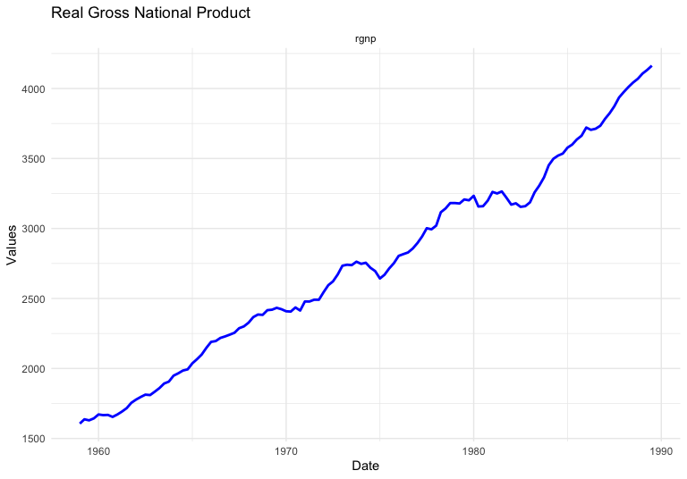
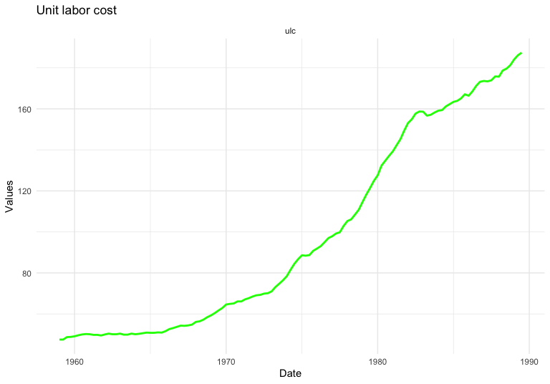
Time Series Plot

Slide 9
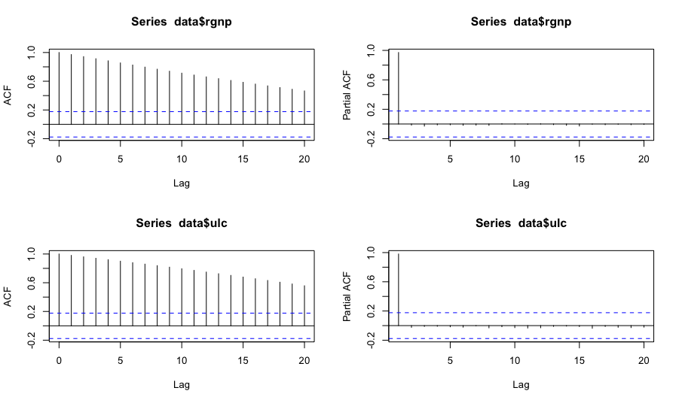
ACF and PACF Plot

Slide 10
Stationarity
Augmented Dickey-Fuller Test
H0: Time Series is not stationary versus H1: Time series is stationary
For Real Gross National Product :
data: data$rgnp
Dickey-Fuller = -2.2621, Lag order = 4,
p-value = 0.4677
alternative hypothesis: stationary
For Unit Labour Cost:
data: data$ulc
Dickey-Fuller = -2.2364, Lag order = 4, p-value = 0.4784
alternative hypothesis: stationary
As both the p-value is greather than 0.05 therefore time series is not stationary

Slide 11
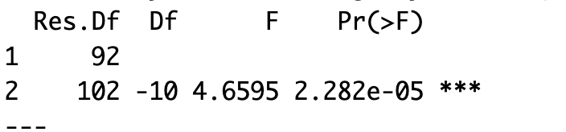
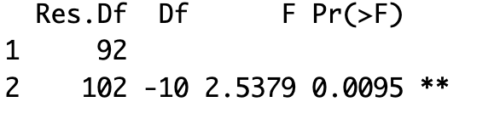
Granger causality Test
The Granger causality test is a statistical hypothesis test used to determine whether one time series can predict another time series
H0: rgnp does not Granger cause ulc. H0: ulc does not Granger cause rgnp
Vs H1:rgnp Granger cause ulc Vs H1: ulc Granger cause rgnp
Conclusion: In the both cases the p-value is less than 0.05. therefore we are rejecting null hypothesis and concluding that both rgnp and ulc dependent on each other and help to predict the values

Slide 12
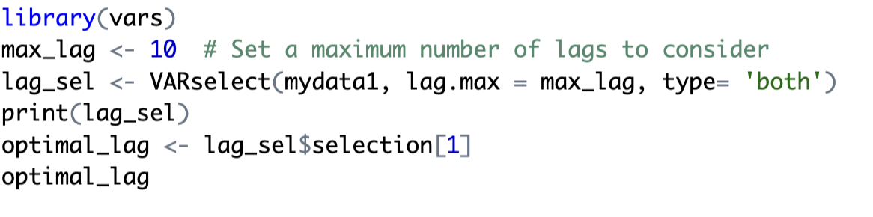
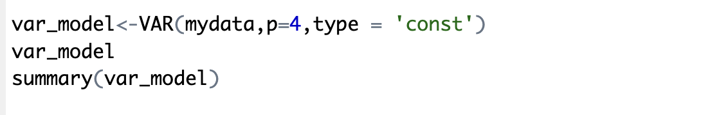
Order Selection and Model Building
AIC value = 5.87700 which is minimum among all the values for the lag 4

Slide 13
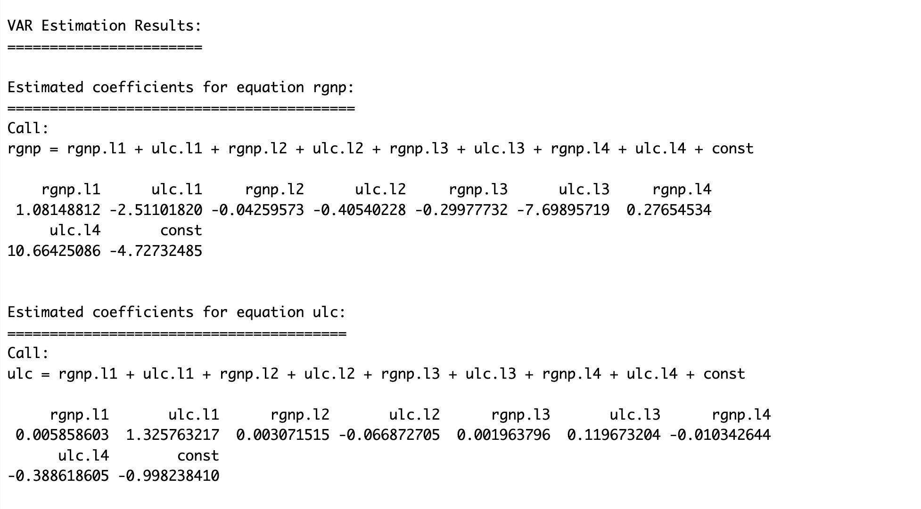
Output

Slide 14
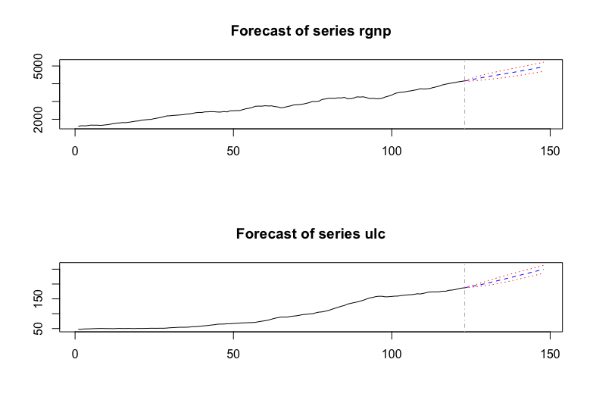
Forecast
Forecast for next 6 years (24 values)

Slide 15
Conclusion
Vector autoregression (VAR) is a powerful tool for forecasting and analyzing multivariate time series data.
It can be used to model both stationary and non-stationary data.
Simulate the behavior of systems under different conditions.
Limitations
VAR models are not well-suited for long-term forecasting
They may also suffer from the curse of dimensionality when dealing with a large number of variables.

Slide 16
Thank you!

